Slide 1

THE $27,000 TripWire
The LinkedIn Client Funnel Process that Gets 60+ High-Ticket Leads a Month…On Autopilot
Pat Henseler
Director of Programs, LinkedSelling
An Inc. 500 Company Each of the Last 2 Years
Notes:
"Who in this room would like a foolproof, iron clad...simple 1 message strategy, for getting at least 99% of the people you reach out to...to never want to talk to you ever again."

Slide 2
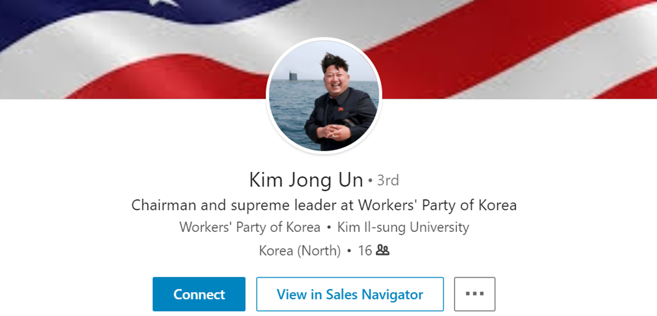
Step 1: Connect
Notes:
Step 1 connect.

Slide 3

Step 2: Pitch
THE $27,000 TripWire
Notes:
Step 2…

Slide 4
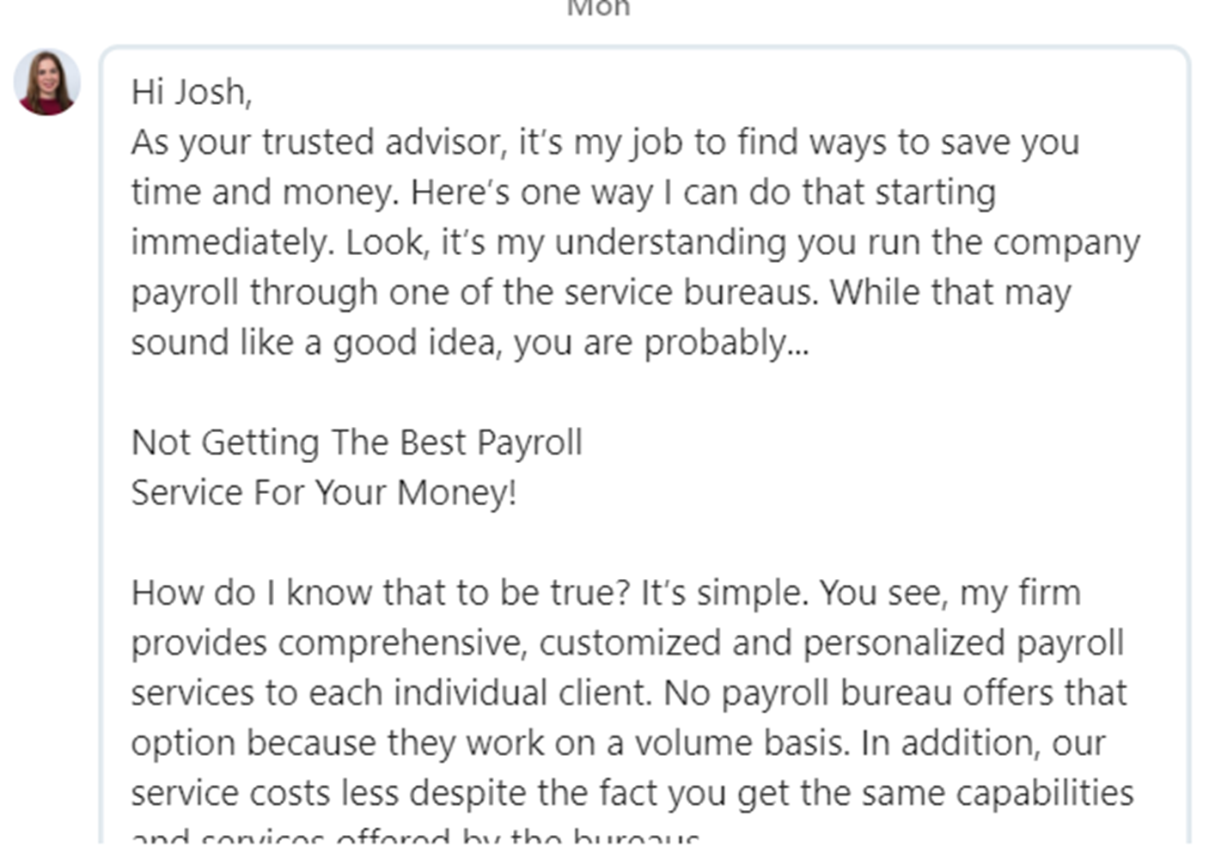
THE $27,000 TripWire
Notes:
“As your trusted advisor, it’s my job to find ways…” Never met this person, but FINALLY a trusted advisor! And boy, I was just thinking about how much I wanted to switch payroll services. No.

Slide 5
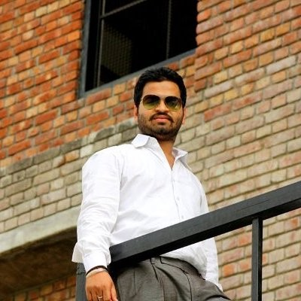
Hi Josh,
Hope you are doing great! I am writing this message to bring your attention to our services. We are a team of young and experienced Website and mobile app developers with experience of 4+ years working with latest frameworks. If you have any web development and mobile app project, we would certainly be delighted to work on it.
If you are interested in our services, I will be glad to tell you more about it and discuss your case!
Regards,
CEO
http://
THE $27,000 TripWire
11:544 PM
Read
Not Sure
No thanks
No, thank you
Notes:
Just connected with this guy, and here’s his leg hump. Not only is this team YOUNG, they are also EXPERIENCED. We all get these kinds of messages...it really gives LI a bad name, and it’s unfortunate, because it doesn’t work. Today I’m going to show you what does work.
Look…even LinkedIn’s automated replies below know that this isn’t going to work.

Slide 6

From two guys in a basement full of spider crickets in St. Louis…
…to running a company viewed as one of the world’s leading authorities…
…on using LinkedIn to get high end clients.
Notes:
I left the corporate world in 2009 and started working as an outsourced CFO. Within a couple years, I had transitioned out of that business, and in late 2011 LinkedSelling was born…and the reason is because….

Slide 7
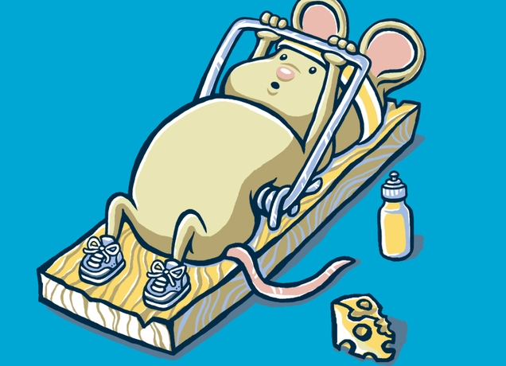
Forget $27 products and services…
we needed a mouse trap that could get me
$27,000 clients…
Notes:
Show of hands…who out there targets clients that have a lifetime value of over 5k? How about 10k? How about 100k?
When LinkedSelling started back in 2010, I doubled down on it…because…it’s the best place to get high ticket clients. Most of the other fluff and stuff people say you should do, it didn’t work for me. I needed to get to the people that could hire me.

Slide 8
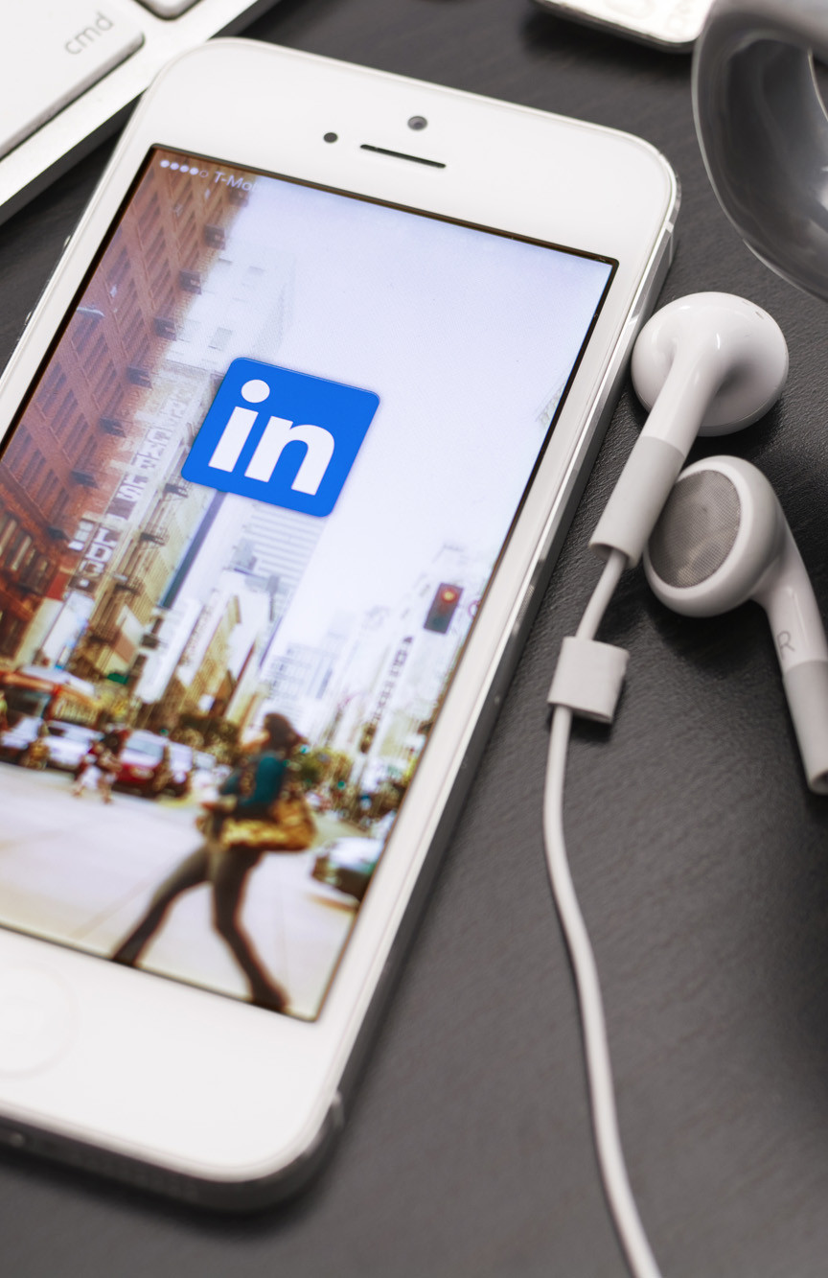
Over 500+ million users
of adult internet users in US are on LinkedIn
25%
Why LinkedIn…
check LinkedIn daily. (76% for executives)
40%
$
Most affluent demographic.
Millions of businesses.
Notes:
You’ve probably all seen or heard these stats at some point. I don’t think I’m breaking news that there’s some serious buying power on LinkedIn.

Slide 9

Nowhere else online can you…
HAND SELECT the EXACT people you want to target.
Notes:
But what it really comes down to is that you can hand select the exact people you want to do business with. And there’s basically nothing else that gives you that ability. It was true back in 2010, and it’s true now.

Slide 10
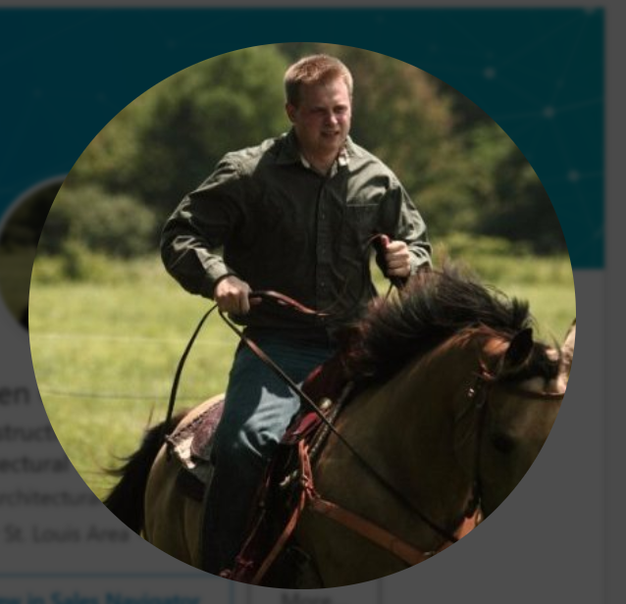
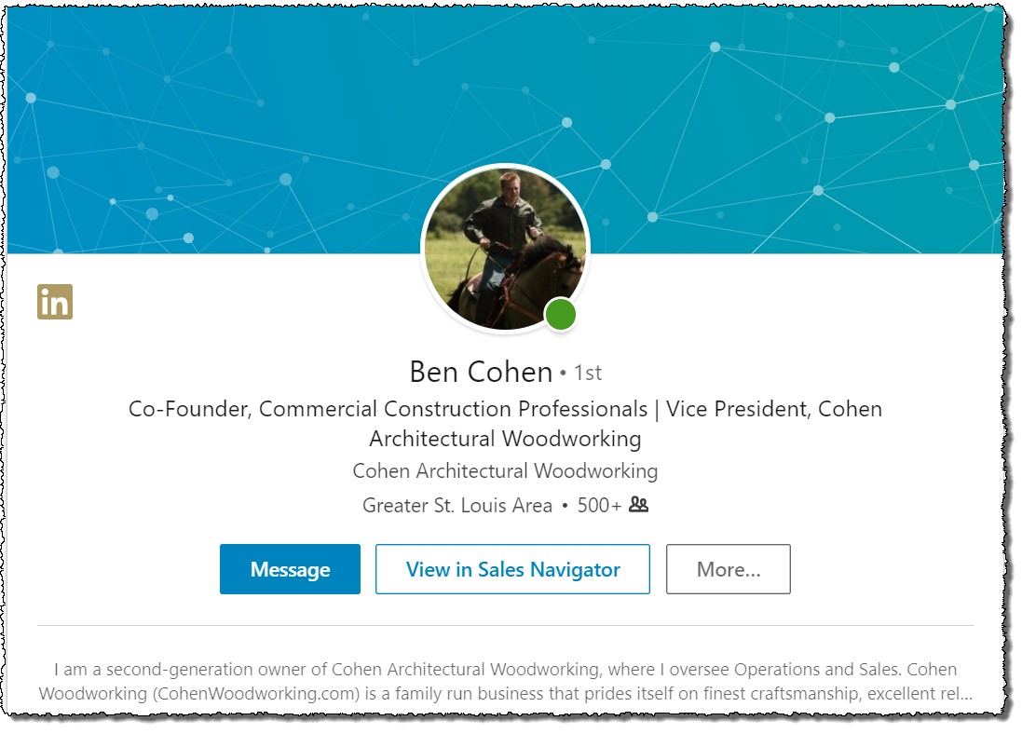
Our first client, Ben Cohen, has done almost $30 million with these strategies
2 Important Take-aways….
Notes:
My very first client Ben Cohen, hired me in 2011 to help him get very high ticket clients off LinkedIn. And he has done $30 Million since. And here’s exactly how he did it….

Slide 11
#1
On 02/16/12 7:43 AM, Ben Cohen wrote:
------------------------------
Hi Tiffany,
I own a 37 year old family owned commercial cabinet company. We deliver and install nationwide. Would you be interested in talking with us about providing cabinets/casework for your new and remodel Fresenius locations? We can also help you come up with cost efficient designs and layouts.
Who would be the best person for me to contact regarding this?
Along with many other projects, since 1986 we have provided cabinets with over 800 Wal-Mart stores.
Thank you,
Ben Cohen
Ben@CohenWoodworking.com
Swipe the exact message used to get this client…
Who would be the best person for me to contact regarding this?
7:24AM
Notes:
This was part of a mutli touch messaging campaign, which I’m gonna teach you today… And this particular approach, you can do this when you are going after corporate decision makers, using the “APPROPRIATE PERSON” technique. Now, I’m going to be showing you a LOT of scripts today…but you don’t have to write em all down…just fill out the card on your seat when I wrap up…and I’ll send you all of the scripts plus a lot more.

Slide 12
#1
2/17/2012
Thanks very much Tiffany. I will give Kirk a call.
Thanks!
On 02/17/12 4:25AM, Tiffany
wrote:
------------------------------
Ben,
Contact Kirk in our Atlanta office. I know that we recently brought on board a millwork fabricator outside Philadelphia on the East Coast, but believe that we are looking for other vendors in other areas of the country. Kirk has been intimately involved with this process. He can be reached at
Thank you!
Sincerely,
Tiffany Ferrell
Swipe the exact message used to get this client…
4:28AM
Notes:
This is the response he got back from that particular message. You see, Tiffany doesn’t want to be bothered…but she’s happy to pawn Ben off on Kirk in her Atlanta Office. So the message is part of it…but you can only get away with this…

Slide 13
#2
Use a picture of yourself on a horse.
Notes:
And that is, that you need to have a picture of yourself on a horse.

Slide 14
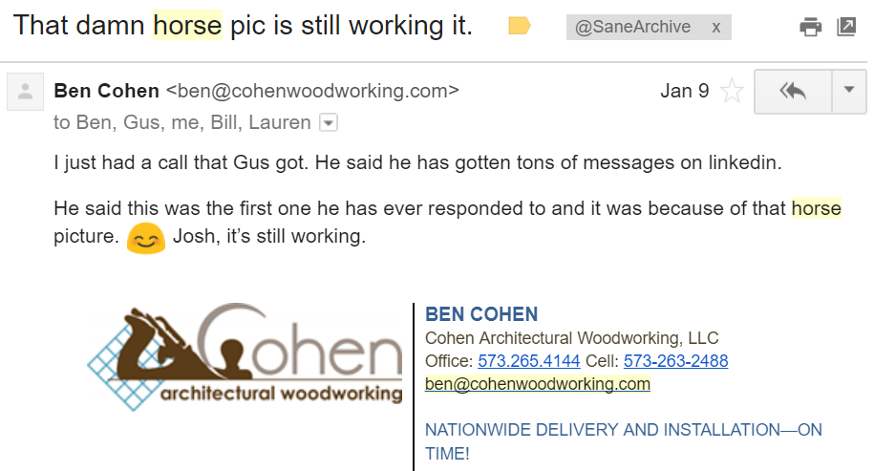

#2
Use a picture of yourself on a horse.
…it was because of that horse picture.
Notes:
Here’s a message I got from Ben last month. IT WAS BECAUSE OF THAT HORSE PICTURE. Josh, it’s still working.

Slide 15
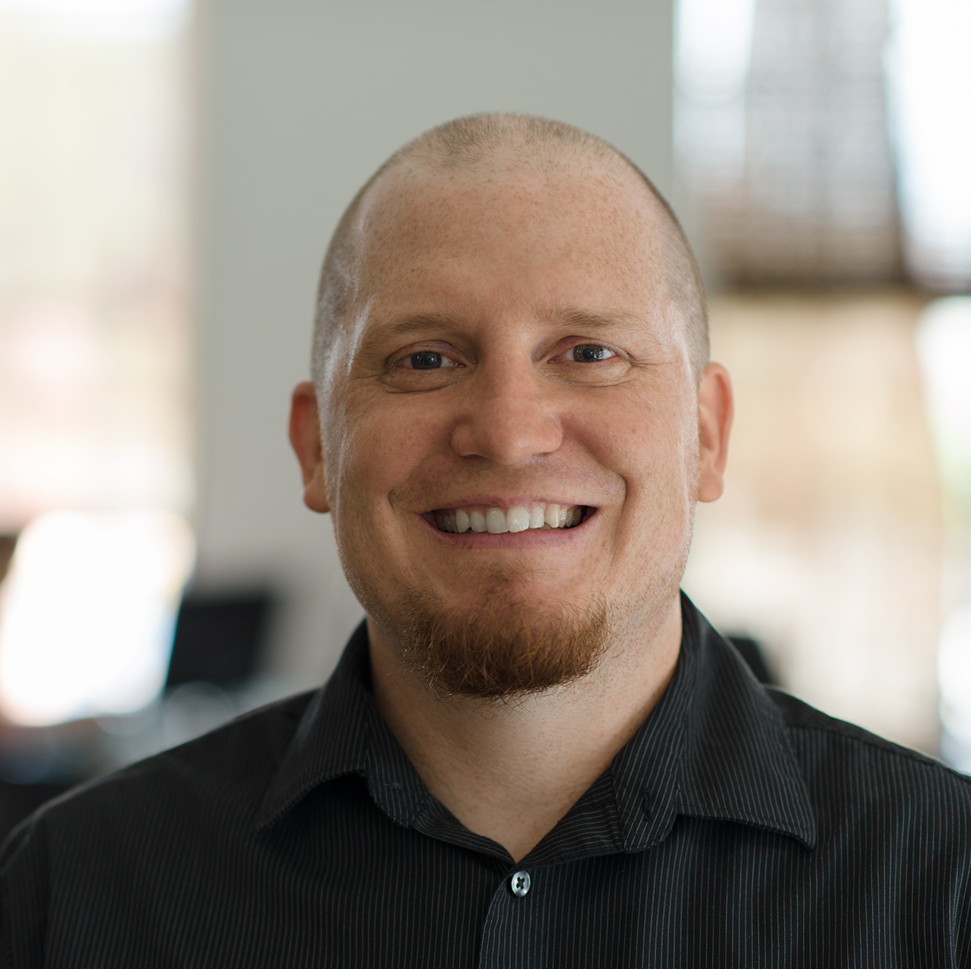
Professional Horse Photographer
Hi, I’m Ben Kniffen
Notes:
So, this first client of mine catapulted our company to where we’re at today…and since then we’ve helped thousands of businesses get similar results.

Slide 16
President & COO at LinkedSelling.
Generated over $1 billion in sales for our clients.
Inc. 5000 3 years in a row.
We launched the LinkedIn lead gen industry.
Hi, I’m Ben Kniffen
Notes:
So, this first client of mine catapulted our company to where we’re at today…and since then we’ve helped thousands of businesses get similar results.
In fact…we used to certify people in our process as a result of our position in the space.

Slide 17
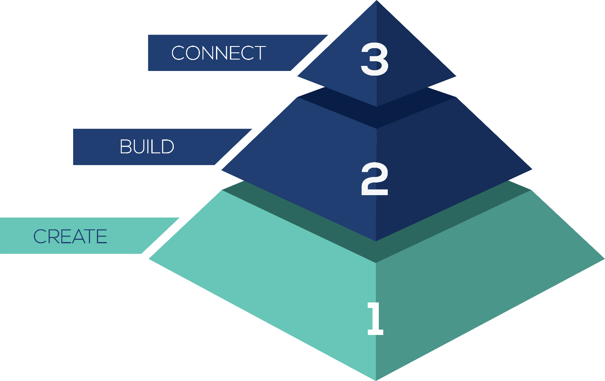
3 Step System We’ve Refined Over 7+ Years
21% Move to Consult
No other method comes close to 21%.
That is why this is so critical for high ticket.
Notes:
And it’s because of this system that I’m going to be walking you through today. When you use it, 21% move to a consult. For when you can’t afford to burn through prospects…21%.

Slide 18
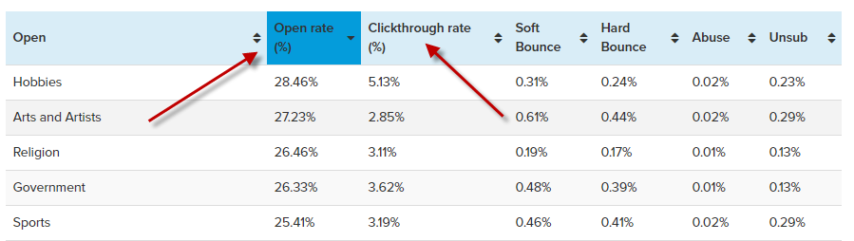
21% Book a Phone Call
Notes:
This is the high end of open rates…that’s an open of an email…only 2.5 -5% click anything – that’s not an appt.

Slide 19
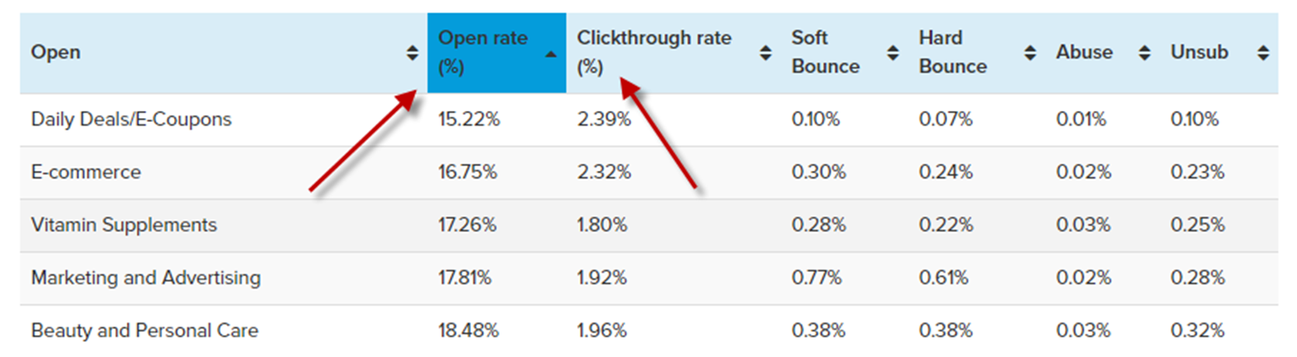
21% Book a Phone Call
Notes:
Here’s the low end…but what about Facebook ads…you’ve probably all heard about facebook ads…and they can work – but what are you looking at.

Slide 20
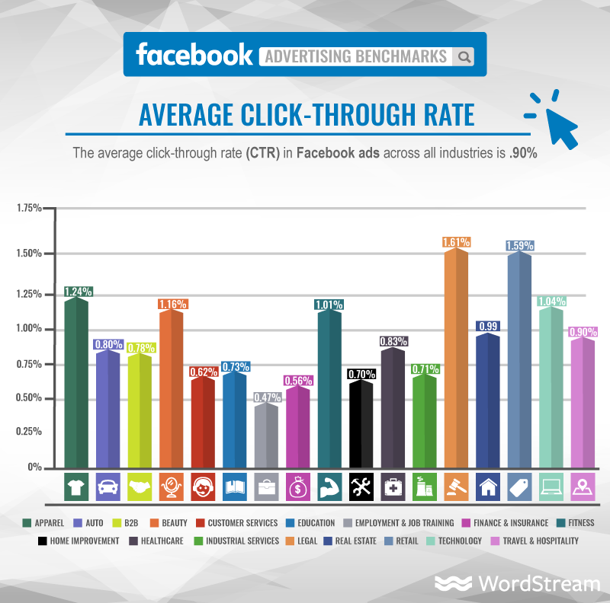
21% Book a Phone Call
Notes:
1% click through and then you can expect typically anywhere from 20-40% of those to convert on your opt-in then a long complicated funnel that HOPEFULLY people make it through to have the chance to book a call or buy your product.
This doesn’t mean there aren’t ways to make these work…but I just want to keep things in perspective when we talk about 21% booking a call.
Sometimes I’ve shown that number and ppl say…well what if I want 100% to book a call?
I say good luck. But here’s the reality. Now – that extra 79% do you just give up…no. But I want to make sure we’re on the same page…
Stop me if you’ve heard this before but…has anyone heard the one about the optimist who fell from the roof of the 100 story building….
Someone down on the 50th floor heard them falling past an open window saying “So far so good.”
Look at what’s available what gives you the best opportunities and go from there…so what is our system…how’s it work.

Slide 21
Systematically building relationships and engineering trust.
Notes:
Our philosophy is that you can use LinkedIn to build a mouse trap, that with the right MESSAGING and POSITIONING, can Systematically build relationships and engineer trust with THOUSANDS of prospects. And this is really important, because most people forget Know. Like. TRUST.

Slide 22
3-Step LinkedIn System…
Notes:
And this is how we do it. #1, Create the POSITIONING you need for the whole system to work.
#2, Build what we call your Authority Leadership Platform.
#3, Connect to targeted prospects, and implement messaging.
Let’s dive in.

Slide 23
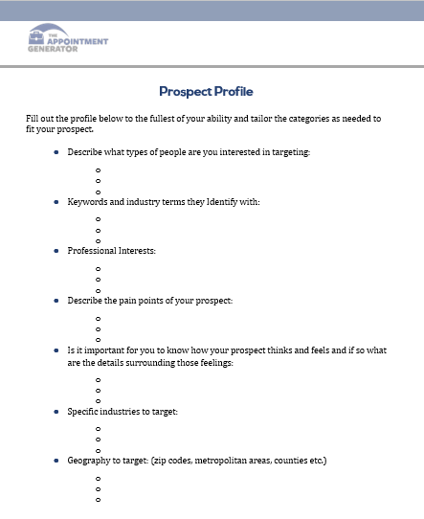
Create Your Prospect Profile
Create Your Prospect Map
Create Your Value Identifiers List
Step 1:
The CREATE Phase
Notes:
I’m going to go quick through this part, because if you fill out the card, you’ll get in depth workbook on implementing each of these. But what it’s all about is a. Profile = Clarity on Avatar
b. Map = where to find them…and this means which groups on LinkedIn are they in.
c. Value Identifiers =what makes them tick, so you know how to position.

Slide 24
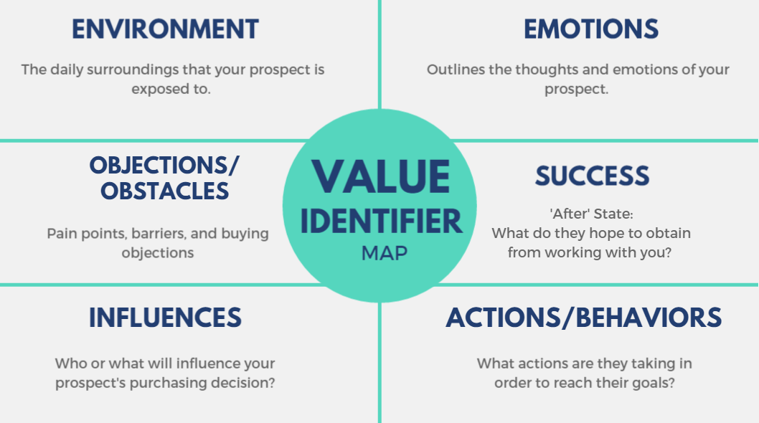
Notes:
And these are some of the things we look at. When you’re armed with this level of intelligence about your prospects, you can start to speak their language. And it informs every other aspect of the system, and most importantly your messaging.

Slide 25
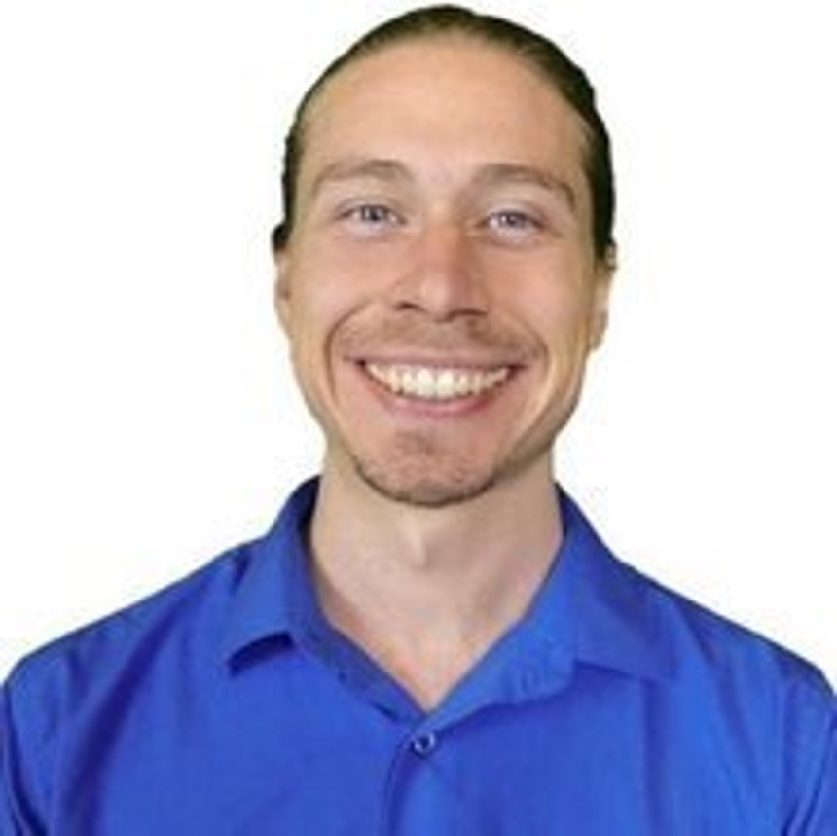

“You can become an authority but it does not require you to generate all of the content.
You can use others content to educate yourself, your clients, and your colleagues. This is a great way of efficiently delivering value. Through Josh’s system, we now have a steady stream of people expressing interest in our business. And we just had our top month last month and did over 45k in revenue!
We are now on our way to be able to phase out of as much in-person and 1-on-1. This will free us up to do more travel, and generate more passive income from our training program and virtual sessions!”
Miles Nichols
Owner of Living Love Mindfulness
Notes:
And the cool thing, is that as I’ll touch on…using this strategy, you don’t have to create any of your own content. We never ask clients to come up with content. We almost always use 3rd party, curated content….and we get amazing results.

Slide 26

But you still need a way to separate from the pack & stand out.
Notes:
But just understanding your prospect isn’t enough. You need a systematic way to stand out, if for no other reason…so that when you reach out…you are not seen as a VENDOR, but as a PEER.

Slide 27
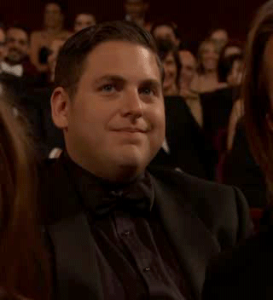
There’s way too much noise out there…
Notes:
Because there is way too much nosie out there. And most of your competitors, they’re just bottom feeding…trying to be noisy. <click> And the clients you’re trying to reach…they’re not going for it any more…and they’ve got their guard up….

Slide 28

You need a way to position yourself as an authority or leader…
Notes:
To break through, you have to be seen as an authority, a leader, a PEER.

Slide 29
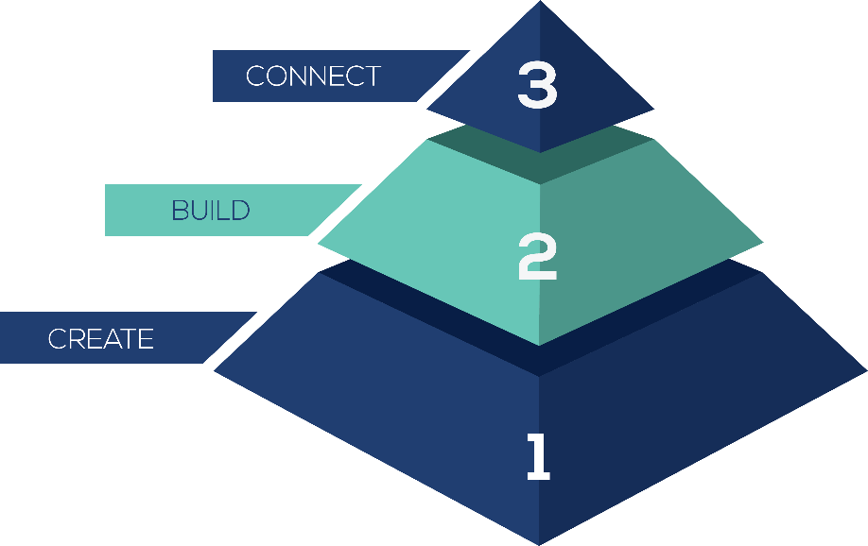
Step 2: Build
Notes:
And that’s where Step 2 comes in, BUILD.

Slide 30
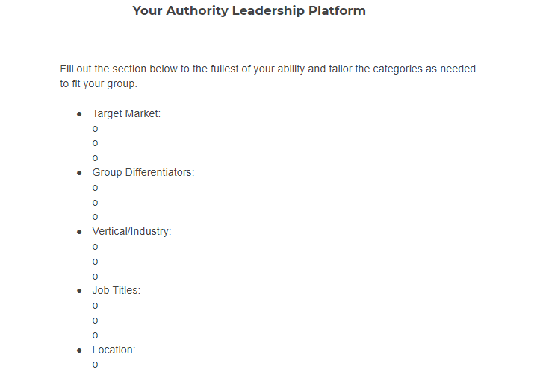
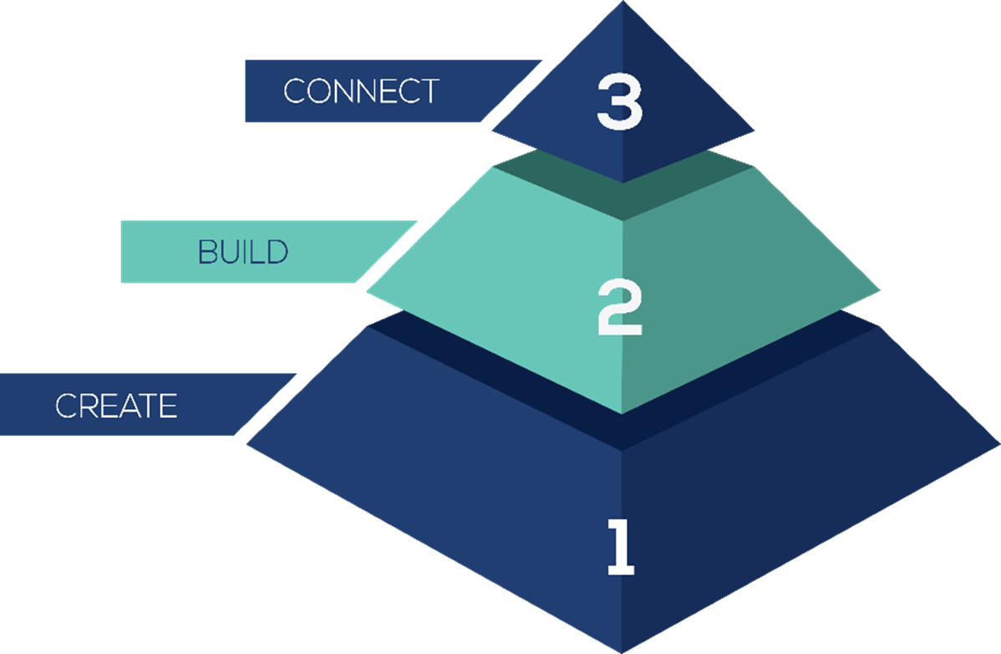
Build a Community of Prospects
Build an Optimized Profile
Build Trust & Authority with Content
Step 2:
The BUILD Phase
Notes:
And the best part about this content guys is that you don’t need to create it yourself…there are systems to curate content efficiently. This is how you really Amplify the authority you are building is by keeping your name and face in front of these people in the RIGHT way.
UPDATE IMAGE OF WORKBOOK

Slide 31

CAVEMAN PSYCHOLOGY
“A lecturer presented a speech to two different groups of students about the importance of arithmetic.
To one group, the presenter was introduced as an award-winning scholar from a prestigious research university.
To the other group, the presenter was introduced as a dishwasher in a restaurant.
The students responded much more strongly to the “professor” than to the “dishwasher.”
Notes:
A harvard study found that when a lecturer presented the same material to 2 groups of students…when the presenter was intro’d as a professor…the students responded much more strongly than when the presenter was intro’d as a “dishwasher.” Which might seem like, duh…but this is what PERCEPTION is all about.

Slide 32
Are you the professor or the dishwasher of your industry?
Notes:
And it’s important that you aren’t seen as just another vendor, just another dishwasher…but a LEADER.

Slide 33
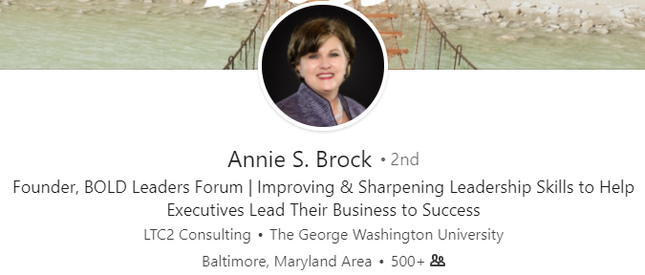
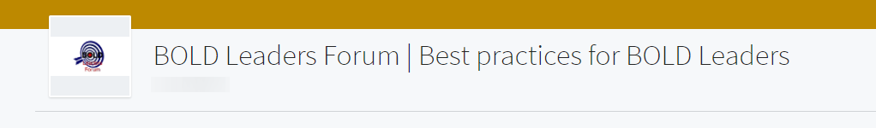
The Authority Leadership Platform
Notes:
So here’s how we do that, by using LinkedIn groups….Annie Brock, as the founder of Bold Leaders Forum…she’s able to position herself as a LEADER for LEADERS.
TALK ABOUT HOW ANNIE FIRST STARTED WORKING WITH US. IT STARTED BY A CONSULTATION ABOUT THE TYPE OF GROUP THAT WOULD WORK FOR HER AUDIENCE.

Slide 34
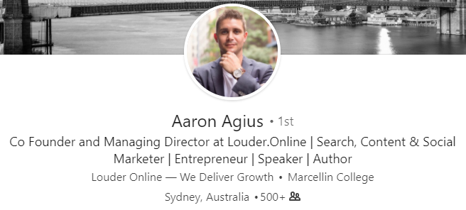
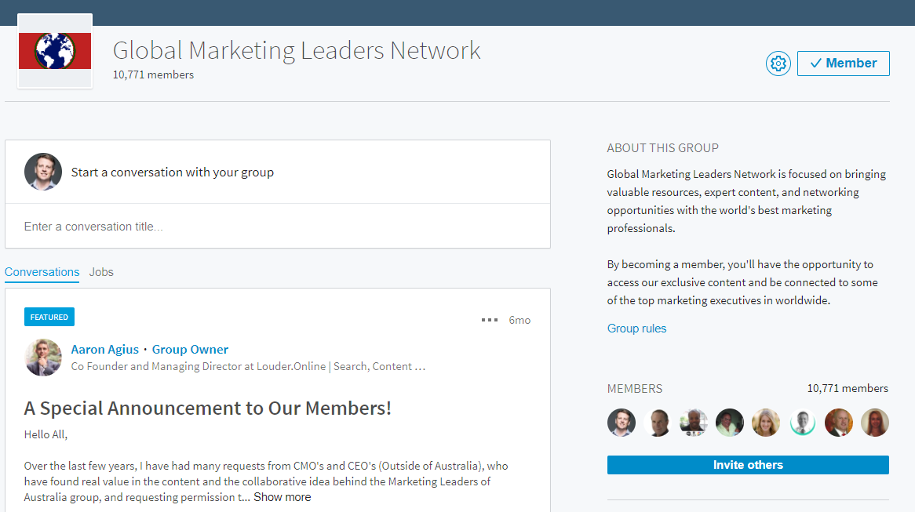
The Authority Leadership Platform
Notes:
Aaron Agius, runs a global marketing agency out of Australia. Over 10,000 prospects in his group. Client of ours since 2013. Because he’s the founder of Global Marketing Leaders, people connect with him that otherwise wouldn’t.
A SIMILAR CONSULTATION WITH AARON…his group shouldn’t be called SEO and CONTENT MARKETING STRATEGIES SO WE GOT HIM IN THE RIGHT MIND THAT IT HAD TO APPEAL TO HIS AUDIENCE AND HOW THEY IDENTIFY

Slide 35
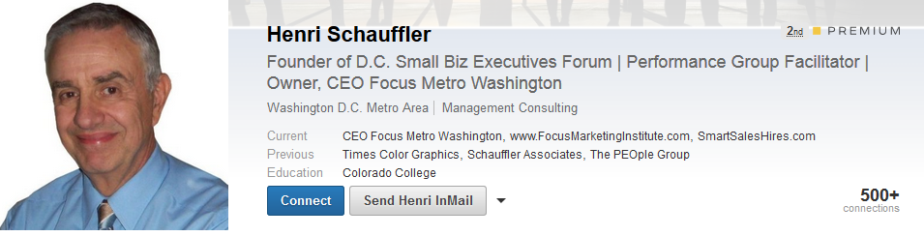
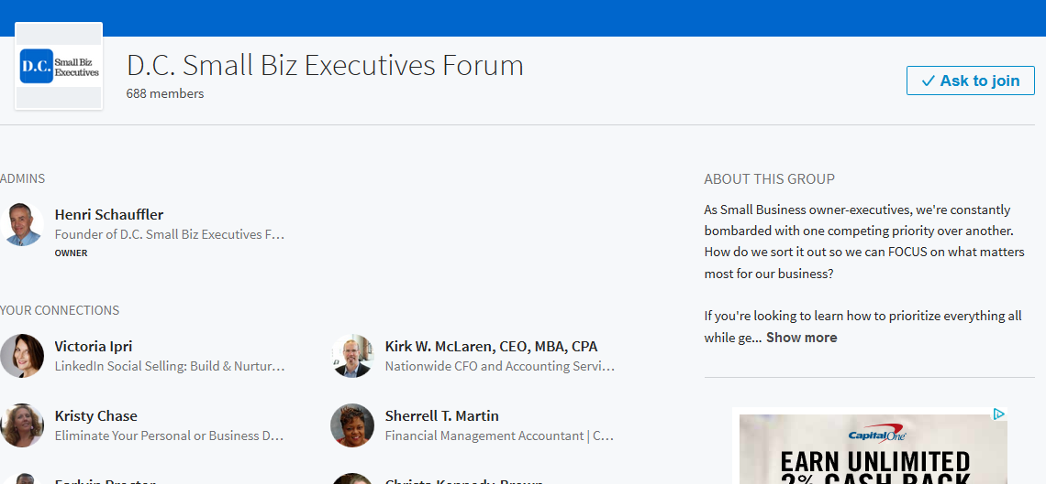
The Authority Leadership Platform
Notes:
Same with Henri Schaufler, and his group DC Small Biz Exec Forum.

Slide 36
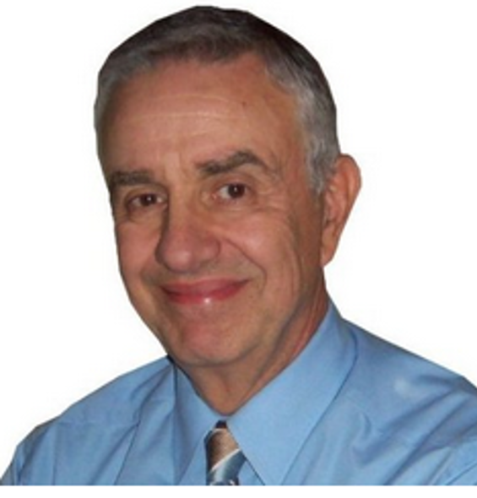
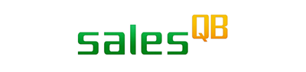
“I have doubled my business in the two years since implementing the system.”
Henri Schauffler
President at SalesQB
Notes:
And the reason it works for him, is because hes not seen as just a consultant…but a leader in his community, so his best prospects are willing to connect with him.

Slide 37
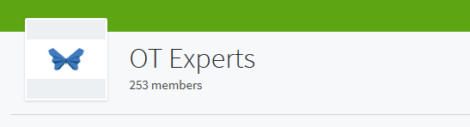
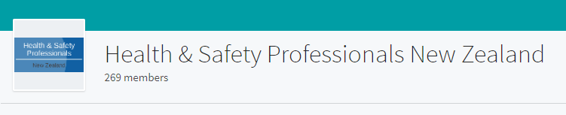
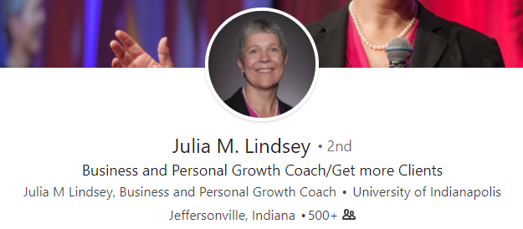
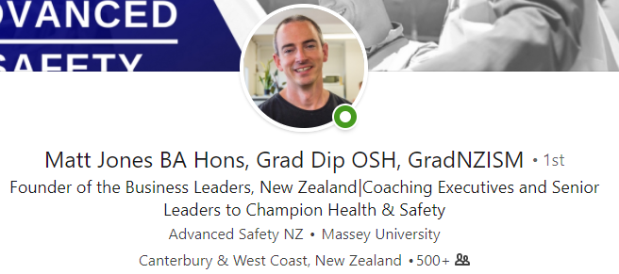
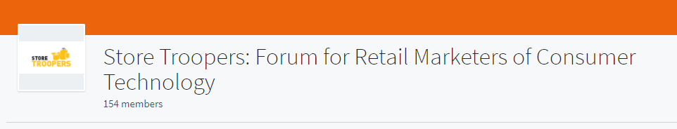
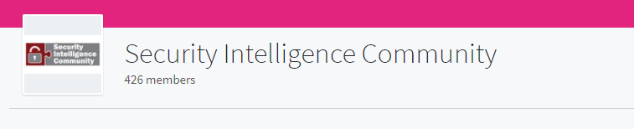
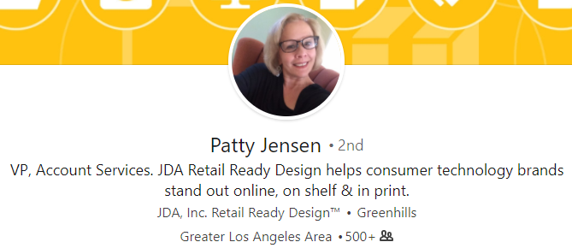
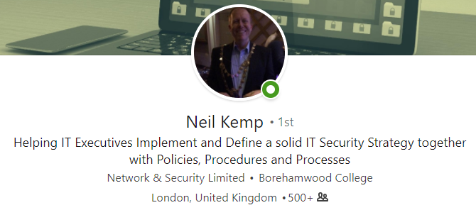
Notes:
Julia Lindsey targets Occupatiioonal Therepaists. Patty Jensen, Retail Marketers. Matt Jones, goes after executives in Health & Safety roles. Neil Kemp helps IT Executives

Slide 38
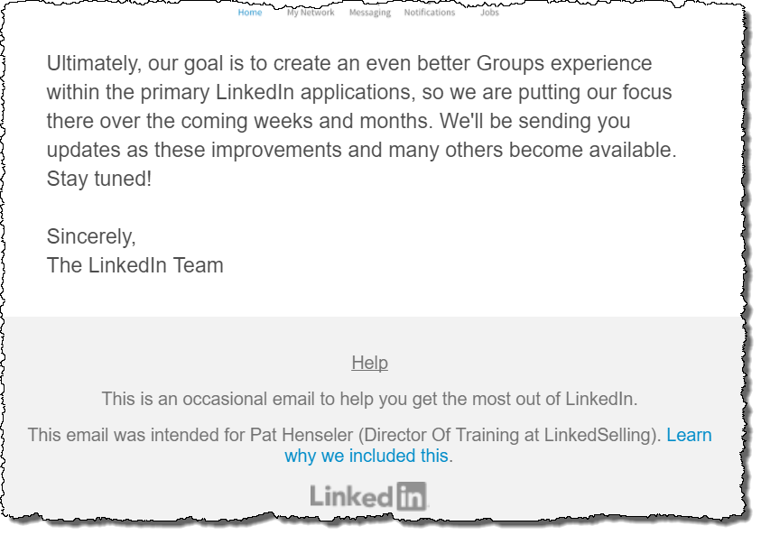
Ultimately, our goal is to create an even better Group experience within the primary LinkedIn applications, so we are putting our focus there over the coming weeks and months. We’ll be sending you updates as these improvements and many others become available. Stay tuned!
Sincerely,
The LinkedIn Team
our goal is to create an even better Group experience
LinkedIn reinvesting in groups post-Microsoft acquisition
Notes:
And this strategy is more exciting today than ever, as LinkedIn post Microsoft acquisition has announced that they investing to create an even better Groups experience.

Slide 39
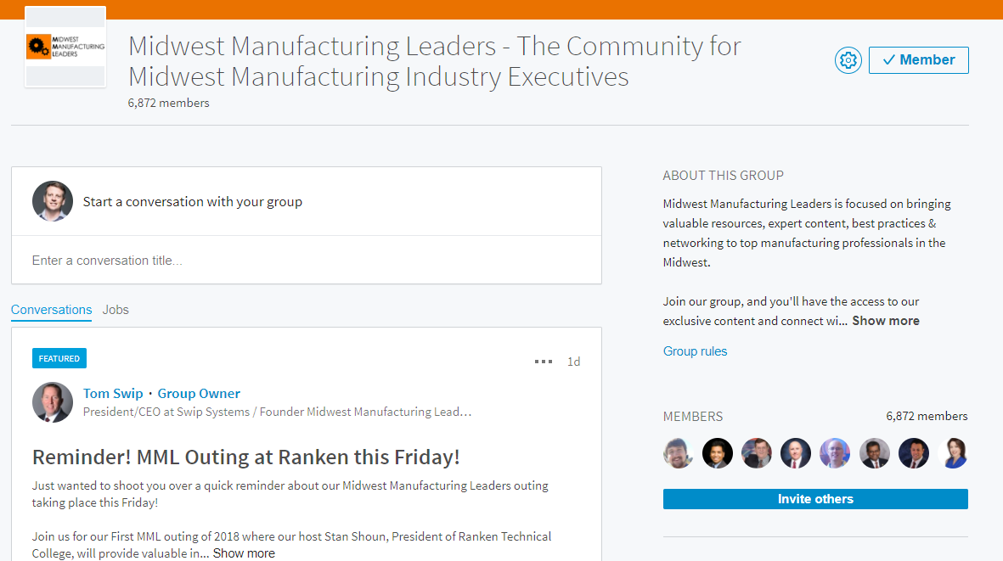
#TCS2018 | @JoshBTurner
Notes:
So one more example, a client of ours Tom Swip. He goes after Manufacturing CEO’s and CFO’s…because he is the founder of MML, he gets in the door and they see his name all the time.
AGAIN IT STARTED WITH WORKING WITH TOM TO UNDERSTAND THE PEOPLE HE WANTED TO TARGET. THE NAME NEEDED TO APPEAL TO THEM

Slide 40
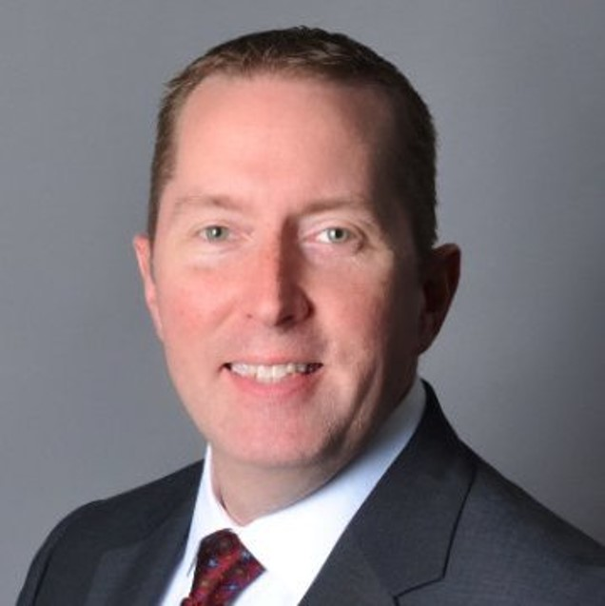

“Over $600,000 in new business.”
Tom Swip
President at SWIP Systems
Notes:
And he’s done a lot of business as a result of the relationships he’s built.

Slide 41
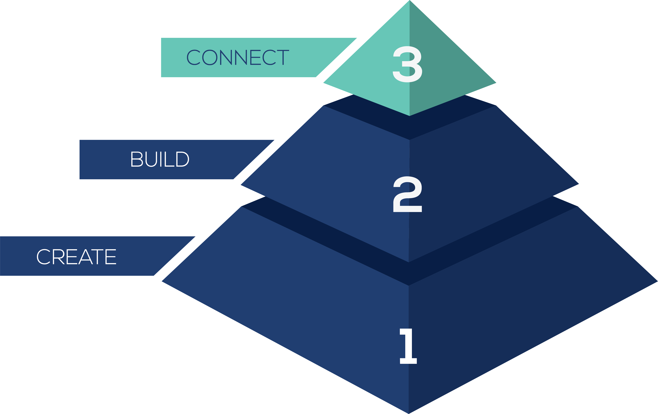
3-Step LinkedIn System…
Notes:
But creating this positioning, and creating this community for your prospecs…that’s not where the big results come from….although it is what enables the next step to work so well. Without everything I just walked you through….you’re just leg humpin. So, step 3 CONNECT. This is where you start connecting with LOTS of prospects, and working them through strategic messaging campaigns that culminate in a request for a phone call.

Slide 42
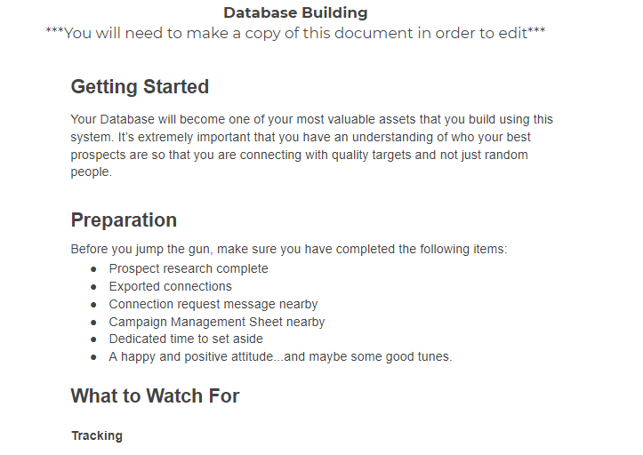
Step 3:
Connect with Your IDEAL Prospects
Connect Via a Multi-Touchpoint Messaging Campaign
Book More Sales Consultations
The CONNECT Phase
Notes:
UPDATE IMAGE OF WORKBOOK

Slide 43
DATABASE BUILD +
ONGOING PROSPECTING
Leverage positioning to get connected to THOUSANDS of ideal, hand-selected prospects
Notes:
The first piece, is what we call the DATABASE BUILD. And we recommend when you start using this approach, that you send at least 1,000 connection requests in your first 30 days…and then each month thereafter, ongoing prospecting to continue adding more connections.

Slide 44
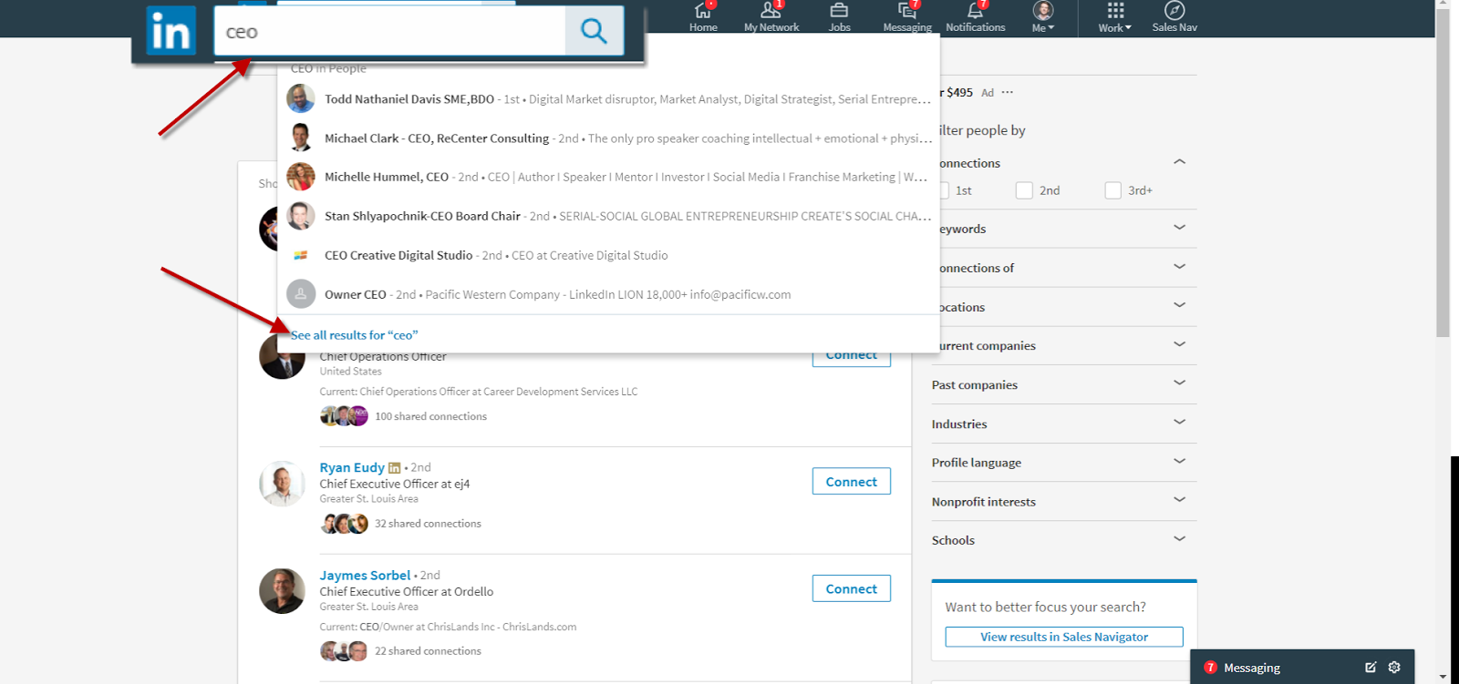
Step 1:
Find Your Prospects
Notes:
Go to the search bar and type the title of the people you want to do business with.
You’ll want to plug in the details for what makes sense for YOUR business. If you are targeting realtors type in Realtor. Marketing Managers? Type in Marketing Manager.
And guys this is the beginning…this is the free account. If you’re using Sales Navigator you can get much more specific with your audience.

Slide 45
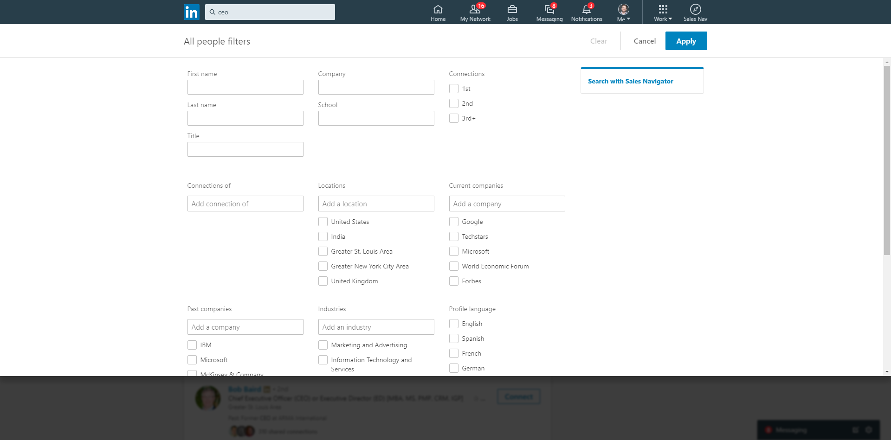
Step 2:
Filter for High-Ticket
Notes:
Go to the search bar and type the title of the people you want to do business with.
You’ll want to plug in the details for what makes sense for YOUR business. If you are targeting realtors type in Realtor. Marketing Managers? Type in Marketing Manager.
And guys this is the beginning…this is the free account. If you’re using Sales Navigator you can get much more specific with your audience.

Slide 46
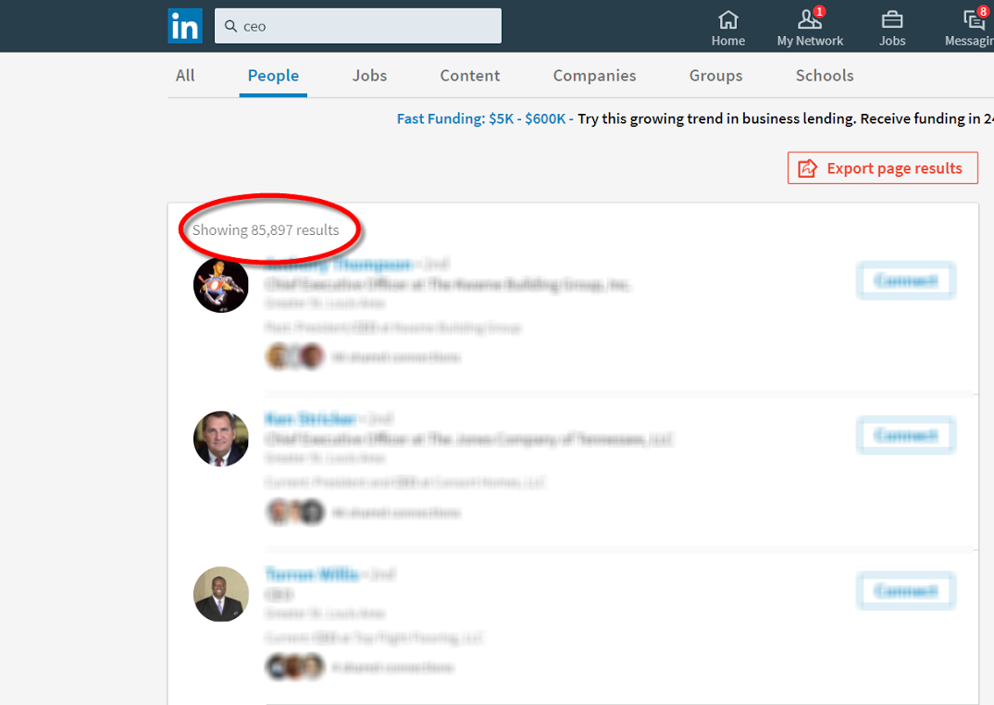
Step 2:
Filter for High-Ticket
Notes:
The thing is guys, for everybody in this room. You’ve got thousands of prospects on LinkedIn. What we like to do is find the 80/20. Your very best clients. That’s the filter.

Slide 47
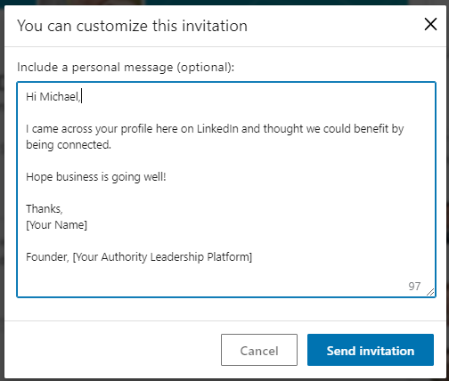
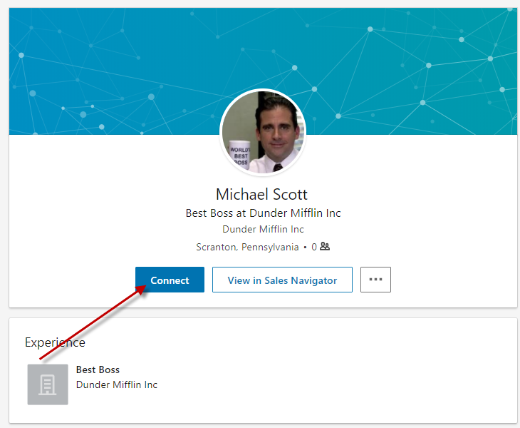
Step 3:
CONNECT
Notes:
So once you find the prospects that are right for you, you want to connect. And here’s a script that works very well. {read script}

Slide 48
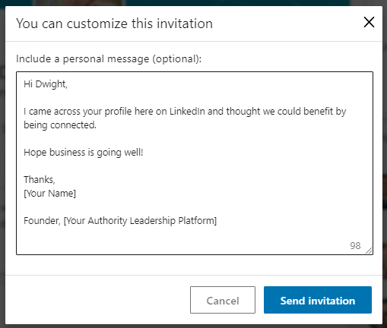
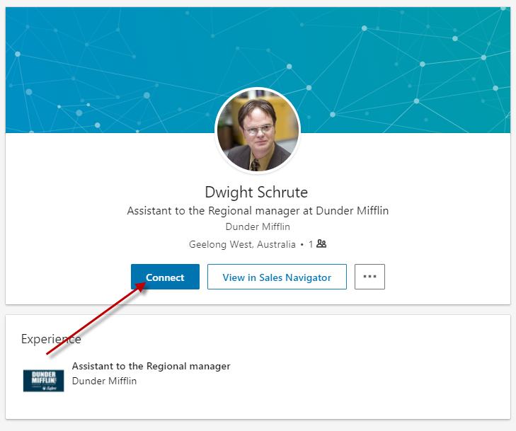
Step 3:
CONNECT
Notes:
So once you find the prospects that are right for you, you want to connect. And here’s a script that works very well. {read script}

Slide 49
Goal = 60 appointments
-----------------------------
300-400 new connections
per month.
Notes:
So if you want to get 60 appointments…you need to plan on adding 300-400 new connections per month. Because remember, 21%. And that’s an average…so if you want to be safe, 400 connections per month.

Slide 50
Goal = 15 appointments
------------------------------75-100 new connections
per month.
Notes:
Now, almost all of our clients start lower than that. Why? Because you want to get things dialed in, and then ramp up. So when you’re getting started, aim for more like 75-100 new connections per month.

Slide 51
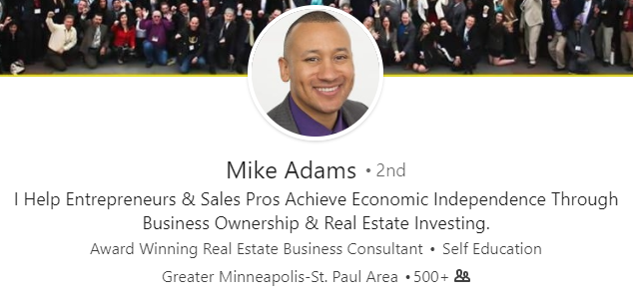
Case
Study
705 prospect leads from month 1 outreach
Notes:
And using this approach, guys it’s really a numbers game. Do the outreach, and you’ll get the leads. Mike Adams, we sent about 1,500 conection requests in the first month, and he got 705 to accept.
NOW MIKE DIDN’T JUST DIVE IN AND APPROACH ANYONE AND EVERYONE. WE SPOKE WITH HIM GAMEPLANNED HOW TO POSITION HIS PROFILE. HOW TO DETERMINE THE BEST PROSPECTS TO GO AFTER. BECAUSE WITHOUT THAT CUSTOM PLAN IT WOULD’VE GOTTEN OFF ON THE WRONG FOOT AND HE’D BE STUCK WITH LIMITED PROSPECTS OR HE’D BE CONNECTED WITH A LOT OF THE PEOPLE THAT AREN’t A GOOD FIT. AND YOU DON’t WANT TO WASTE YOUR TIME GOING AFTER UNQUALIFIED PEOPLE.

Slide 52
Case
Study
4,506 prospect leads from ongoing outreach
Notes:
And here’s Aaron Agius, after a couple of years of working the system.

Slide 53
Turning prospects into appointments.
Notes:
So now we’ve got tons of connections….what do we do next? How do we turn all these connections into bonafide sales appointments?

Slide 54
Multi-Touchpoint Messaging Campaign
Initial Connection
High Value Prospects
Message 1
“Thanks for Connecting”
Message 2
“Interesting Article”
Message 3
“Request Phone Call”
Message 4
“Follow Up”
Week 1
Week 3
Week 5
Week 7
Notes:
Through a process we call the M.T.M.C. 4 to 7 message process to nurture, provide value, build the relationship and book an appointment. 21% agree to a phone call. Compare that to your email list...if you could work your email list and get 20% of your prospects to raise their hand...you'd be on the main stage instead of Ryan Deiss. That's what makes this process so unique.

Slide 55

“All other things being equal, the more familiar an item is, the more attractive it is.
People prefer faces they’ve seen ten times to equally attractive faces they’ve seen only five times.”
Dr. Elliot Aronson
Notes:
One reason it works, is because…. the more often people see something, the more comfortable they are with it simply because they’ve seen it before. Why is this? Largely because of what’s known as priming. Priming works like this: When someone is exposed to a message repeatedly, they naturally start to believe and trust it. The higher the exposure, the deeper the trust.

Slide 56
Multi-Touchpoint Messaging Campaign
Initial Connection
High Value Prospects
Message 1
“Thanks for Connecting”
Message 2
“Interesting Article”
Message 3
“Request Phone Call”
Message 4
“Follow Up”
Week 1
Week 3
Week 5
Week 7
Notes:
THIS…is how we go from low results and a lot of burned bridges from this >>next slide<<

Slide 57
Step 2: Pitch
THE $27,000 TripWire
Notes:
To this

Slide 58
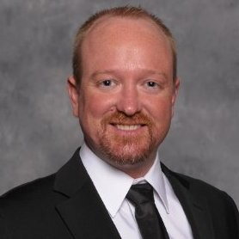
Hi Tom,
Thanks for the note! Your business seems very interesting and I’d love to learn more. When can we chat some time?
Best,
Mike
mike@
THE $27,000 TripWire
2:55 PM
Read
Absolutely
Sure!
Hi Mike

Slide 59
Case
Study
“I’ve turned over more than $100,000, I’m organizing a national conference for my health and safety professionals groups and really, by and large, it’s all thanks to this system.
I was living day to day, not knowing where the next lead was, or how the next bill would be paid. Now, I’ve got enough in the bank where I can confidently forecast the next 6-12 months, expand the business and contract work out. I’m also seen as an authoritative figure, where people are turning to me for advice.”
Notes:
Not just for big companies like Ben Cohen I showed you earlier, Matt Jones is a client that we love who went from living day to day, to getting his business to six figures within 12 months.

Slide 60
“I have doubled my business in the two years since implementing the system.”
Henri Schauffler
President at SalesQB
Notes:
And this

Slide 61

“My boyfriend and I were able to leave our jobs! We now have enough clients to pay us 3 times what we made at our regular jobs. Every month! Not just some months... And it has been less than 1 year, so we are still expanding. Our goal this year is to be in the top 1% of earners in Idaho. What a difference a year can make!!!
Luda Drummond
Owner at ClickWhipt
Notes:
And this

Slide 62
“Over $600,000 in new business.”
Tom Swip
President at SWIP Systems
Notes:
And this. And guys I could go on all day…but really this is just the beginning there is a lot more you can do.

Slide 63

Roger Lopez,
Vice President of Operations
…
Sep 12
Hi Roger,
I hope this note finds you well.
My colleague Jason Lewallen saw that you and I are connected and mentioned he was planning on reaching out to you for a quick phone call. I thought it would be good to do bit of a warm introduction.
As you may already know, my company Home Care Sales provides a variety of offerings to home health businesses and I think you two would have a really productive conversation about your company and the industry. If you don’t mind I’d like to pass your info along to Jason to schedule an introductory call.
Let me know a good time and contact number and I’ll send your information over to him.
Warm regards,
Cheryl
Hand off the call to one of your reps…
2:18 PM
Hello Cheryl,
Have Jason reach out next week.
Thanks,
Roger
7:50 PM
Notes:
Now what if you don’t want to be the one to accept the calls. Here’s how we handle that.

Slide 64

Another Playbook.
It depends!!
Notes:
And maybe the most important point I wanted to make, is that the greatest results come from the STRATEGY for YOUR business. We test a lot of different things, and here’s an example of a different type of messaging playbook. You can see for the clients who we’ve tested this with, it’s getting really good results….but it’s not right for everybody. So what we do when we start with a client – is to sit down to really understand where your business is, your goals, and then we map out for you the EXACT strategy that will work in your business.
That’s where it all starts. It’s where we began with Tom and Henri and Luda and Matt and Annie and all the examples I’ve shown you today. But if there’s one thing you get out of this presentation today I hope it’s that you don’t jump the gun…and you don’t turn into just another vendor or ‘leghumper’ out there…you need to…

Slide 65
Follow up!!!!!
Notes:
Now, did you notice how many Follow Ups we had in that last example.

Slide 66
Prospect
Contact #1
50% of sales people have given up
Contact #2
85%of sales people have given up
Contact #3
79%of sales people have given up
You harvest low-hanging fruit
Contact #4
89%of sales people have given up
Contact #5
Just now you are becoming a factor in your prospect’s mind
Contact #6
Nurturing slowly, your prospect gets to know you
You harvest low-hanging fruit
Contact #7
You are probably the only person to make 8 contacts with this person
Contact #8
At this point when your prospect is ready to buy, you have a 90% chance of being called
Contact #9
Contact #10
Contact #11
Contact #12
Customer
Notes:
Here’s why.

Slide 67

Message 1
Message 2
Message 3
Message 4
Follow Up Email 3
Follow Up Email 2
Follow Up Email 1
Notes:
The playbook that works best is to send 4-6 messages on LinkedIn and then FOLLOW-UP…at least 2 emails – warm email. Then enter into long term monthly drip sequence. Personal, informal, checking in type messages. If you guys want, I've got a year's worth of these follow up messages and templates, you’ll get those too when u fill out the card.
Now, this is one area where you can turn things on AUTOPILOT for the long haul…once you have it all set up, use tool like Connect 365 to do this.

Slide 68
Let’s do the math…
60 appointments per month
Notes:
So let’s do the math…what do you need to do to get to 60 appointments per month.

Slide 69
1,000 connection requests sent per month = 400 new connections
Each worked through 2-3 month messaging campaign
To get to 60 appointments per month…
800-1,200 prospects messaged per month
2 messages per month
1,600-2,400 total messages per month
80-120 per day, 5 days a week
Notes:
So like we talked about eearlier, you need 400 connections. Better send 1,000 requests to get that. Each will be worked through 2-3 month campaign.
So you need 800 to 1,200 being messaged per month to hit the right cadence.
And they’re getting about 2 messages per month.
So that comes out to 1,600 to 2,400 total messages per month…or 80-120 per day, 5 days a week. And roughly 20 hours a week of prospecting, connection requests, messaging, and managing the campaign.

Slide 70
250 connection requests sent per month = 100 new connections
Each worked through 2-3 month messaging campaign
To get to 15 appointments per month…
200-300 prospects messaged per month
2 messages per campaign
400-600 total messages per month
20-30 per day, 5 days a week
Notes:
Most people start at a lower volume, aiming for about 15 appointments per month with their very best, 80/20, whale clients. That's where we recommend most of our clients to start.
And here’s what those metrics look like. 250 new connections a month, work them through the same process, you end up needing to send 400-600 messages per month. And for an account manager on my team, doing this work for a client of ours, it takes them roughly 20 hours a month to do this work.

Slide 71
3-Step LinkedIn System…
Notes:
But what enables these results guys, is the WHOLE system. When people try and shortcut it, they don’t get the same results.

Slide 72

#TCS2018 | @JoshBTurner
Notes:
So to recap, you create the foundation. Then your Authority Leadership Platform.
You use that Positioning for your Database Build + Ongoing Prospecting.
Then convert those prospects through Messaging Campaigns that include LinkedIn Messages as well as email follow ups after a certain point in the process.

Slide 73
ROI
Do the math yourself.
If you had just 15 new high ticket appointments each month….what would that mean to you over the course of the next few years?
Notes:
So if you’re considering doing this, all you need to do is a little simple math to figure out.....15 high ticket, highly targeted leads each month….what’s that going to be worth to you, and be conservative….evne if you only got 10% to do business with you….what would the numbers look like? If it’s significant, then I implore you to not just let this be another good idea that you don’t implement.

Slide 74

Text UPDATE to
314-279-3277
Notes:
If you want to sit down and have a 1-on-1, my team is here and we’re booking times to map out this entire strategy for you. You can get a time booked, by either turning in your card, or go to Dan or Jamie in the back, and sign up for a time right now.

Slide 75



TEXT ‘EXPO’
TO 314-279-3277
Notes:
to map out this entire strategy for you – just text expo
to 314 – 279 -3277
Look there are over 30 pages here – full of scripts exercises, and more to help you take action and get started.
Now I promised I’d give you the whole system – that’s where it’s at. Be sure to download that. And if you’re interested in having a conversation – we’ll have an option available to set that up.

Slide 76
“Where do I start?”
Notes:
And this. And guys I could go on all day…but really this is just the beginning there is a lot more you can do.

Slide 77
“Who is the right prospect to target for my business on LinkedIn?”
Notes:
And this. And guys I could go on all day…but really this is just the beginning there is a lot more you can do.

Slide 78
“How do I get connected with them?”
Notes:
And this. And guys I could go on all day…but really this is just the beginning there is a lot more you can do.

Slide 79
“How do I get more of these prospects on the phone?”
Notes:
And this. And guys I could go on all day…but really this is just the beginning there is a lot more you can do.

Slide 80
“What’s the most effective follow-up strategy?
Notes:
And this. And guys I could go on all day…but really this is just the beginning there is a lot more you can do.

Slide 81
Text UPDATE to
314-279-3277
Notes:
If you want to sit down and have a 1-on-1, my team is here and we’re booking times to map out this entire strategy for you. You can get a time booked, by either turning in your card, or go to Dan or Jamie in the back, and sign up for a time right now.
INSERT IMAGE OF The POST – IT BOARD

Slide 82

Let’s Map Your Playbook!
Notes:
If you want to sit down and have a 1-on-1, my team is here and we’re booking times to map out this entire strategy for you. You can get a time booked, by either turning in your card, or go to Dan or Jamie in the back, and sign up for a time right now.
INSERT IMAGE OF The POST – IT BOARD

Slide 83
Let’s Map Your Playbook!
4,506 prospect leads from ongoing outreach
Notes:
And here’s Aaron Agius, after a couple of years of working the system.

Slide 84
“My boyfriend and I were able to leave our jobs! We now have enough clients to pay us 3 times what we made at our regular jobs. Every month! Not just some months... And it has been less than 1 year, so we are still expanding. Our goal this year is to be in the top 1% of earners in Idaho. What a difference a year can make!!!
Luda Drummond
Owner at ClickWhipt
Notes:
And this

Slide 85

Let’s Map Your Playbook!
Notes:
Or like our first client Ben Cohen who has done over $30 million in revenue from just this one strategy…this one channel. Guys that’s all it takes. There are a million different shiny objects…but this is end-to-end the marketing campaign that gets results. If you need more opportunities, more at-bats with your IDEAL, qualified prospects – you don’t need to be everywhere and have a snapchat strategy, and a twitter strategy, and a Instagram strategy. – it all starts with a conversation to map out the strategy you should employ on LinkedIn. If you’d like a customized roadmap of how to make this work for your business – see our team at the back now.

Slide 86
Text UPDATE to
314-279-3277
Notes:
If you want to sit down and have a 1-on-1, my team is here and we’re booking times to map out this entire strategy for you. You can get a time booked, by either turning in your card, or go to Dan or Jamie in the back, and sign up for a time right now.
INSERT IMAGE OF The POST – IT BOARD

